Slide 1
Hybrid Inheritance

Slide 2
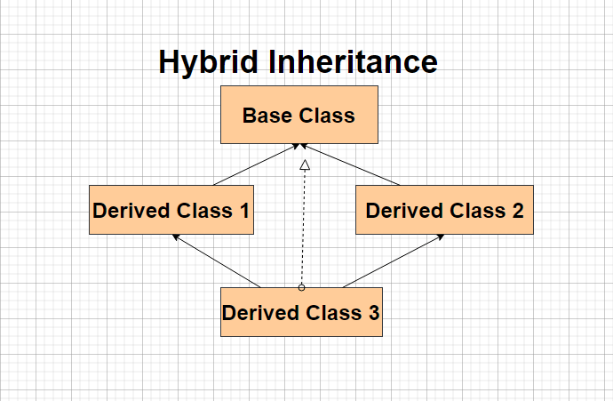
Hybrid Inheritance
Hybrid Inheritance involves derivation of more than one type of inheritance.
Like in the given image we have a combination of hierarichal and multiple inheritance.
Likewise we can have various combinations.

Slide 3
Diagramatic Representation of Hybrid Inheritance

Slide 4
How to implement Hybrid Inheritance in C++
class A
{
// Class A body
};
class B : public A
{
// Class B body
} ;
class C
{
// Class C body
};
class D : public B, public C
{ // Class D body
};
Hybrid Inheritance is no different than other type of inheritance.
You have to specify the access specifier and the parent class in front of the derived class to implement hybrid inheritance.

Slide 5
Access Specifiers
In C++ we have basically three types of access specifiers :
Public : Here members of the class are accessible outside the class as well.
Private : Here members of the class are not accessible outside the class.
Protected : Here the members cannot be accessed outside the class, but can be accessed in inherited classes.

Slide 6
Example of Hybrid Inheritance
class A
{
public:
int x;
};
class B : public A
{
public:
B()
{
x = 10;
}
};
class C
{ public:
int y;
C()
{
y = 4;
}
};
class D : public B, public C
{ public:
void sum()
{
cout << "Sum= " << x + y;
}
};

